Slide 1

Unit 1
Common Responsibilities and Procedures

Slide 2

Unit 1 Objectives
Describe the main duties or tasks of the EDSD.
Describe the various functional relationships in the incident support organization.
Identify factors for effective communication.
Discuss the EDSD’s limits of authority within the expanded dispatch organization.
Identify factors for managing stress.

Slide 3

There was LIGHTNING

Slide 4
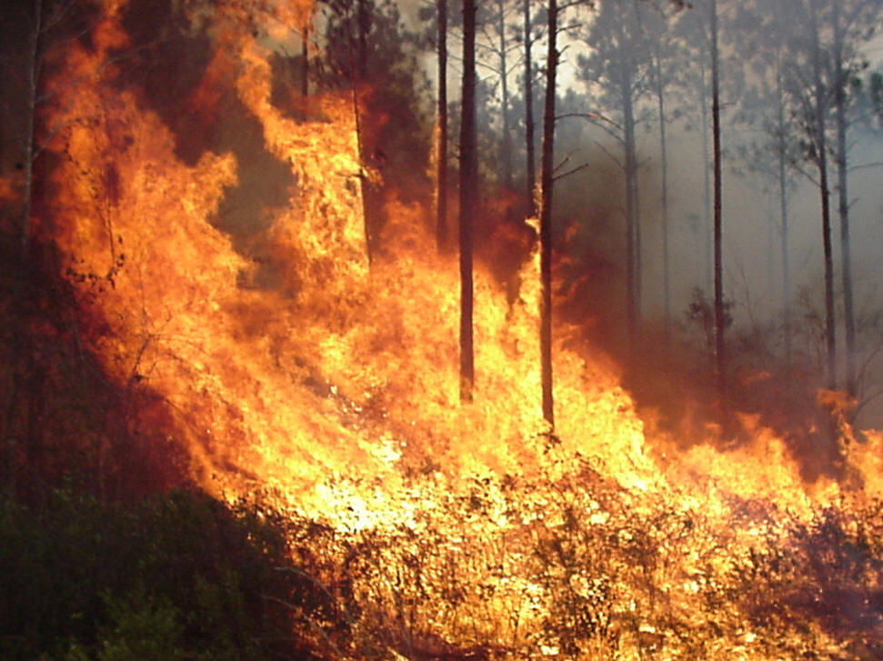
Which ignited FIRE

Slide 5
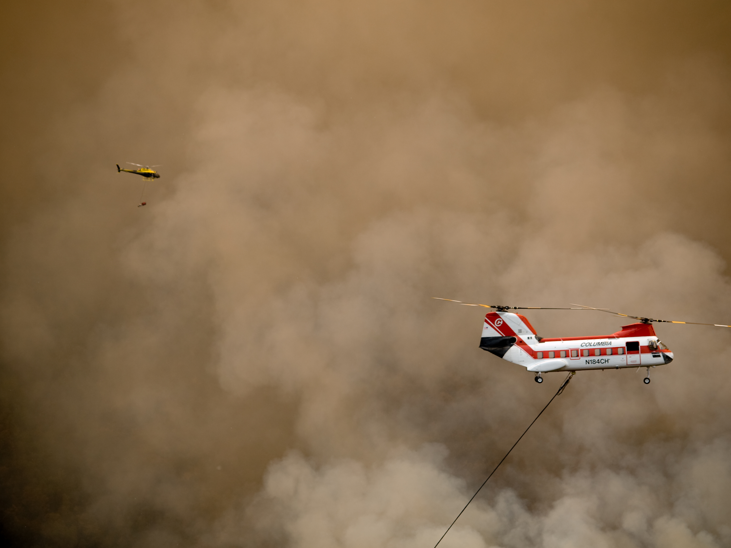
HELICOPTERS Arrived
Slide 1-5

Slide 6

AIRTANKERS Arrived

Slide 7
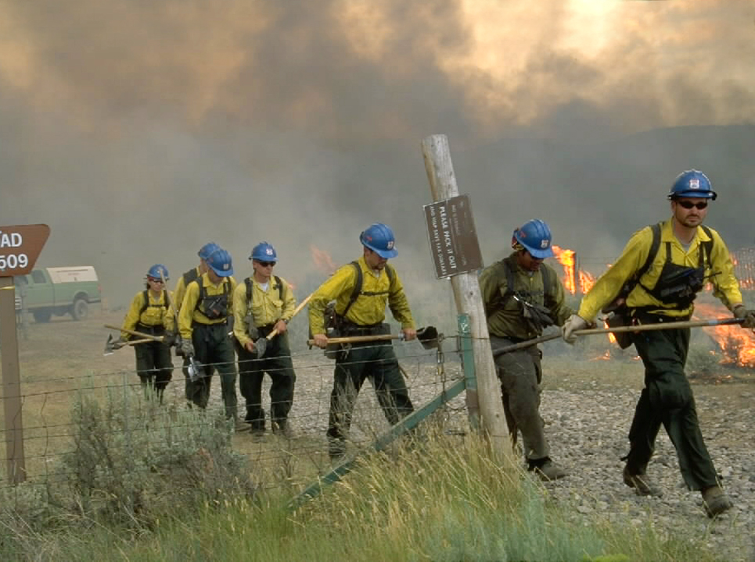
FIRE CREWS Arrived

Slide 8
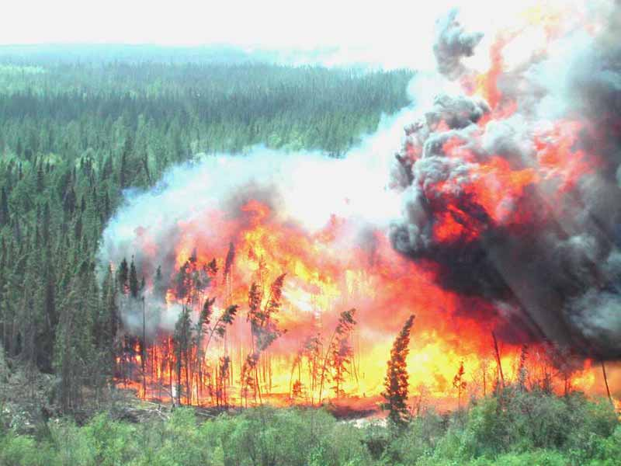
THE FIRE RAGED!

Slide 9

EXPANDED DISPATCH is established

Slide 10
Example Expanded
Dispatch Organization
Supervisory
Dispatcher
Support
Dispatcher
Support
Dispatcher
Support
Dispatcher
Support
Dispatcher
Dispatch
Recorder
Dispatch
Recorder
Dispatch
Recorder
Dispatch
Recorder

Slide 11


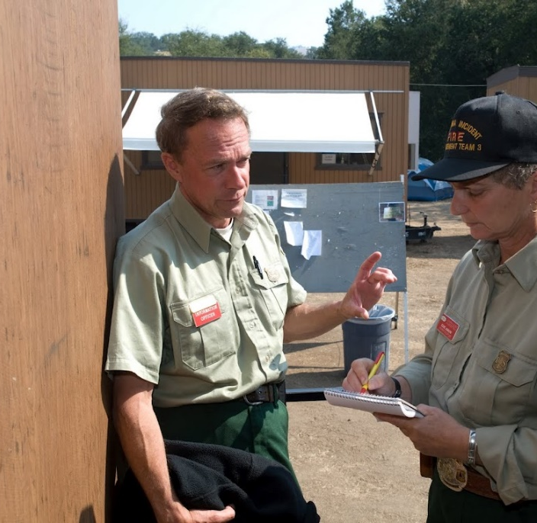
EDSD Main Duties or Tasks
You are on your way to your EDSD assignment.
What will your main duties be?
What do you do first?

Slide 12

EDSD Main Duties or Tasks
Task 1
Upon arrival, obtain initial briefing from supervisor or agency dispatcher.

Slide 13
EDSD Main Duties or Tasks
Task 2
Gather information necessary to assess situation, determine priorities, and take appropriate action.
-Current situation
-Expected duration
-Status of orders
-Resources committed
-Ordering procedures
-Priorities
-Organizational structure
-Operational period schedules
-Housing and transportation availability
-Authority limits
-Not-to-exceed order times
-How to display tracking information
-Internal/external key contacts
-Procedures for media/contractor calls

Slide 14
EDSD Main Duties or Tasks
Task 3
Conduct self in a professional manner.
Task 4
Establish and maintain positive interpersonal and interagency working relationships.

Slide 15


EXERCISE:
TEAM-BUILDING
Notes:
Hold on screen until Task 5

Slide 16
EDSD Main Duties or Tasks
Task 5
Apply the ICS.
  Follow chain of command.
  Maintain appropriate span of control.
  Use appropriate ICS forms.
  Use appropriate ICS terminology.

Slide 17
EDSD Main Duties or Tasks
Task 6
Conduct or participate in briefings with relief dispatchers, dispatch recorders and supervisory dispatchers.
  Pertinent information regarding operational period activities.
  Priorities.
  Procedural issues or changes regarding mobilization/demobilization.

Slide 18
EDSD Main Duties or Tasks
Task 7
Participate in After Action Reviews (AAR).
Task 8
Review Resource Order for completeness and accuracy.
  Follow up to confirm information as appropriate.

Slide 19
EDSD Main Duties or Tasks
Task 9
Use national, area, and local forms supplementing the resource order.
  Recognize when use of supplemental forms is required.
  Verify accuracy and completeness.
  Process using appropriate ordering channels.

Slide 20
EDSD Main Duties or Tasks
Task 10
Communicate effectively at various levels.
  Consult with and provide feedback to work supervisor.

Slide 21
EDSD Main Duties or Tasks
Task 11
Prioritize work and make decisions concerning functional area.
  Ensure subordinates understand assignment for operational period.
  Continually evaluate performance of assigned personnel.
  Provide guidance and/or assistance to dispatch recorders.
  Provide training as necessary.

Slide 22
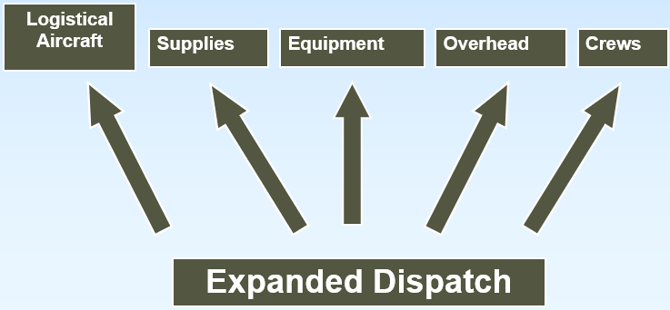
Expanded Dispatch Functional Organization

Slide 23
EDSD Main Duties or Tasks
Task 12
Identify staffing and equipment needs to work supervisor.
Task 13
Use existing sources and contract agreements to obtain resources.

Slide 24
EDSD Main Duties or Tasks
Task 14
Use pertinent reference guides to validate resource capabilities, limitations, or regulations governing use.

Slide 25
EDSD Main Duties or Tasks
Task 15
Use appropriate reference materials.
  Mobilization guides
  Contracts
  Expanded Dispatch Plan or Dispatch Operations Guide
  NFES catalog
  Appropriate user guides

Slide 26
EDSD Main Duties or Tasks
Task 16
Obtain information necessary to process a non-commercial logistical flight for personnel or cargo.

Slide 27
EDSD Main Duties or Tasks
Task 17
Reassign resources to support an incident.
  Consider safe and cost-effective results for actions.
  Summarize resource information to provide intelligence support.
  Use established methods and ordering channels.
  Communicate with internal/external entities.

Slide 28
EDSD Main Duties or Tasks
Task 18
Mobilize resources to support an incident.
  Consider safe and cost-effective results for actions.
  Summarize resource information to provide intelligence support.
  Use established methods and ordering channels.
  Communicate with internal/external entities.

Slide 29
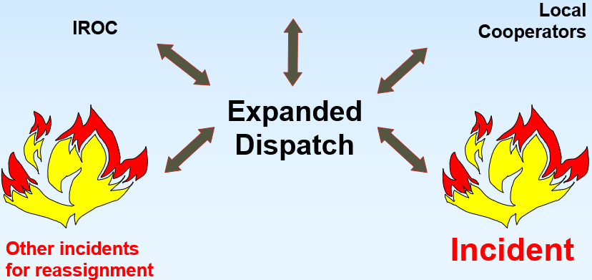
Local Fill
Other dispatch centers accessible through local agreements
Neighbors

Slide 30
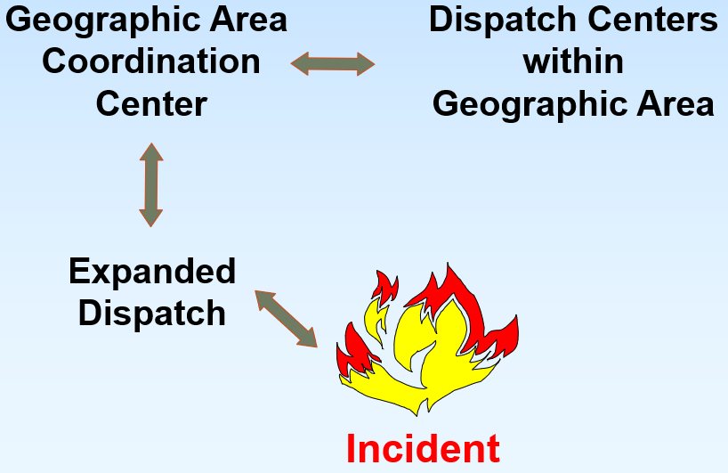
Within the Geographic Area

Slide 31
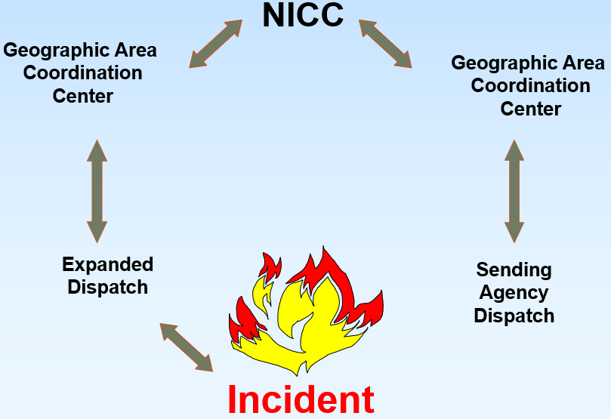
Outside the Geographic Area

Slide 32
EDSD Main Duties or Tasks
Task 19
Effectively utilize resource tracking and status systems.
  Compile and maintain current status of resources using established local systems.

Slide 33
EDSD Main Duties or Tasks
Task 20
Demobilize resources to support an incident.
  Consider safe and cost-effective results for actions.
  Identify resources being released that are reassignable.
  Ensure Resource Order/Request closure.
  Use established methods and ordering channels.
  Ensure demobilization procedures are followed.
  Communicate with internal/external entities.

Slide 34
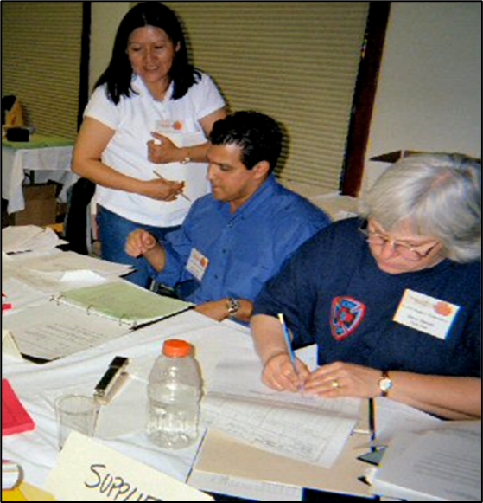

EDSD Communication
Internal entities
External Entities

Slide 35
EXERCISE
COMMUNICATION

Slide 36


Managing Stress
Internal (yourself)
External (environment)
Organizational (dispatch system)

Slide 37
Unit 1 Objectives
Describe the main duties or tasks of the EDSD.
Describe the various functional relationships in the incident support organization.
Identify factors for effective communication.
Discuss the EDSD’s limits of authority within the expanded dispatch organization.
Identify factors for managing stress.

